Slide 1
Computer System

Slide 2
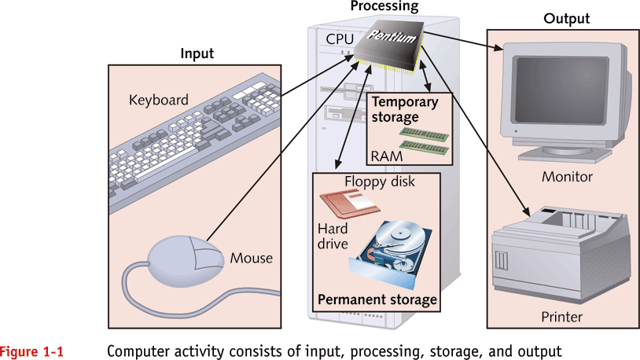

Computer System
Is a collection of related components that have all been designed to work together smoothly.
Computer System.ppt

Slide 3
Hardware
- the physical components of the computer, including the computer itself and matched peripherals.
Software
- the programs that run the computer.
Data
- are facts, or unorganized raw materials, which can be made up of words, numbers, images, or sounds.
Information
– data that has been processed.
Computer System.ppt

Slide 4
?!
Bit - the smallest unit of data that a computer uses. It can be used to represent two states of information, such as Yes or No.
Byte - is equal to 8 Bits. A Byte can represent
256 states of information, for example,
numbers or a combination of numbers and
letters. 1 Byte could be equal to one character.
Computer System.ppt

Slide 5
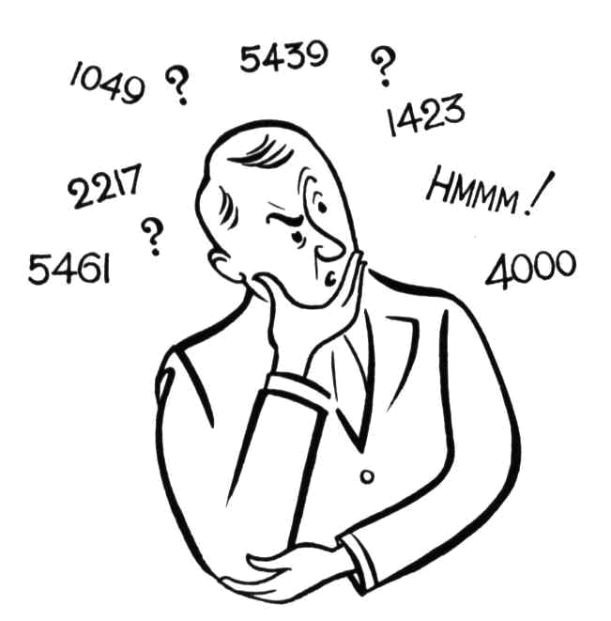
How big is BIG??
Fact 1: Kilobyte
1 Kilobyte would be equal to this paragraph you are reading, whereas 100 Kilobytes would equal an entire page.
Computer System.ppt

Slide 6
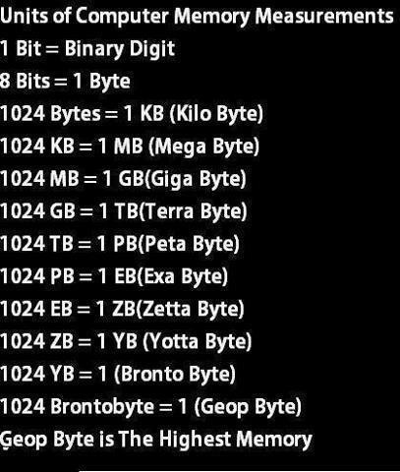

Slide 7

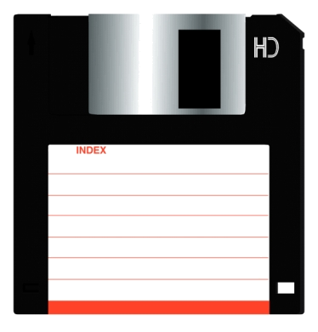
How big is BIG??
Fact 2: Megabyte
One of those old 3-1/2 inch floppy disks can hold 1.44 Megabytes or the equivalent of a small book.
Computer System.ppt

Slide 8
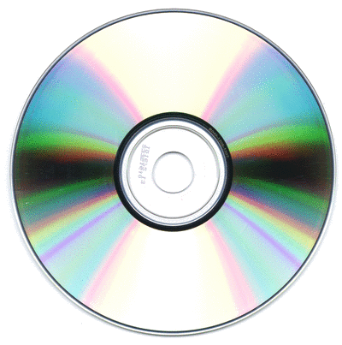
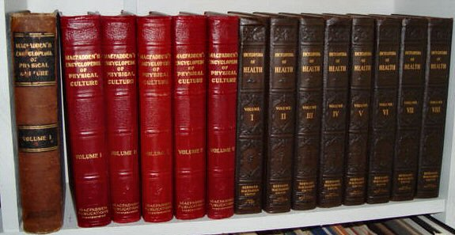
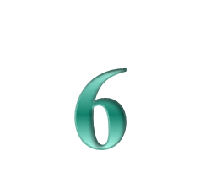
How big is BIG??
Fact 2: Megabyte
100 Megabytes might hold a couple volumes of Encyclopedias.
650 Megabytes is about the amount of data that will fit on a CD-ROM disk.
Computer System.ppt

Slide 9
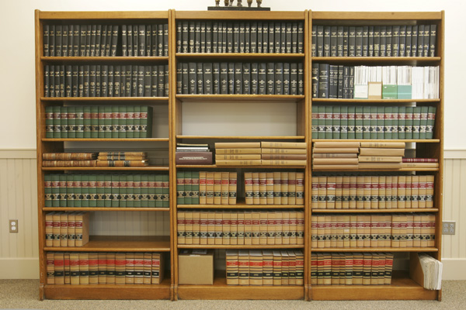
How big is BIG??
Fact 3: Gigabyte
1 Gigabyte of data is almost twice the amount of data that a CD-ROM can hold.
1 Gigabyte could hold the contents of about 10 yards of books on a shelf. 100 Gigabytes could hold the entire library floor of academic journals.
Computer System.ppt

Slide 10
How big is BIG??
Fact 4: Terabyte
To put it in some perspective, a Terabyte could hold about 3.6 million 300 Kilobyte images or maybe about 300 hours of good quality video. A Terabyte could hold 1,000 copies of the Encyclopedia Britannica. Ten Terabytes could hold the printed collection of the Library of Congress.
Computer System.ppt

Slide 11
HARDWARE

Slide 12
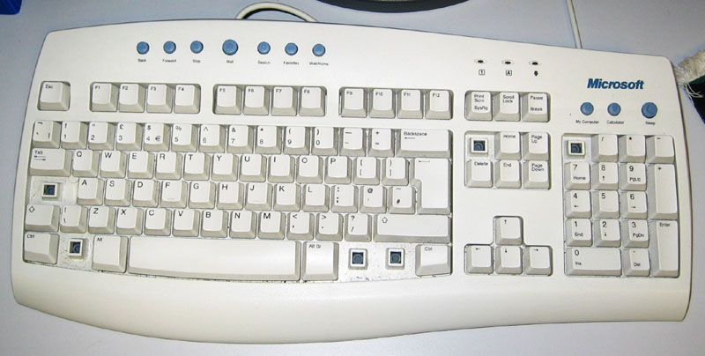
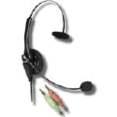
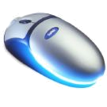
Computer System Components
Input - getting data into the computer
Input Devices
– enable users to get data into the computer for processing
Computer System.ppt

Slide 13
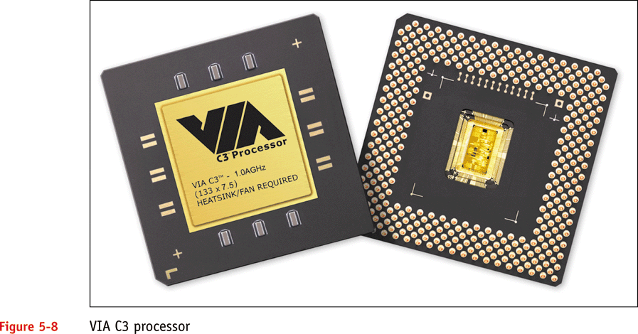
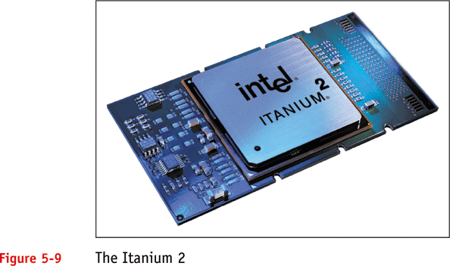
Computer System Components
Processing - transforming data into information
Microprocessor is simply a small processor fabricated on a chip of silicon
Computer System.ppt

Slide 14
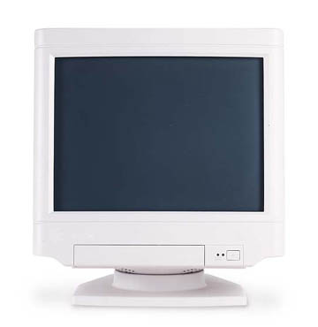
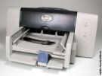
Computer System Components
Output – displaying the information
Output devices – enable users to see and/or produce processed informations
Computer System.ppt

Slide 15
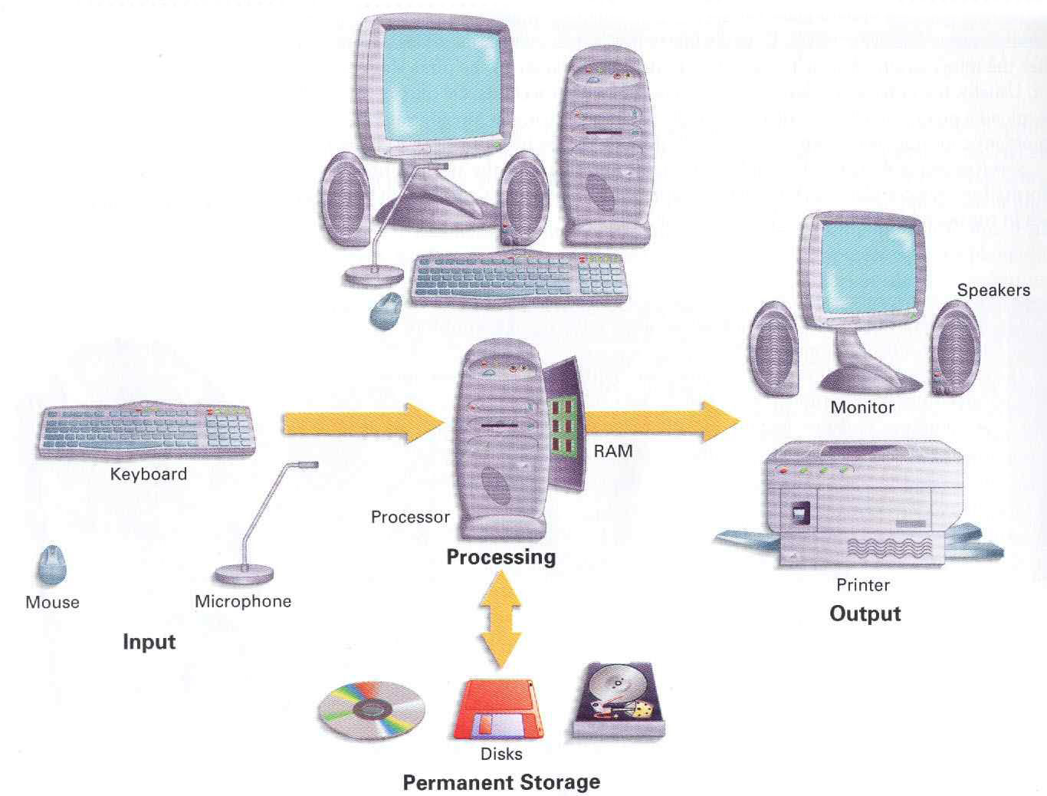
Computer System.ppt

Slide 16
Characteristics of Computer
Speed
Arithmetical and Logical Operations
Accuracy
Reliability
Storage
Retrieving Data and Programme
Automation
Versatility (Flexible)
Consistency
Communications

Slide 17
SOFTWARE

Slide 18
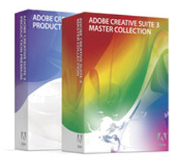
What is a Software?
Software – refers to any program that tells the computer system what to do.
Computer System.ppt

Slide 19
Categories of Software
System Software – programs that take control of the PC on start-up, and then play a central role in everything that happens within a computer system by managing, maintaining, and controlling computer resources.
Application Software – designed and created to perform specific personal, business, scientific processing tasks.
Computer System.ppt

Slide 20
System Software
Operating System (OS)
Monitors and controls all input / output and processing activities within a computer system. It is a program that controls the PC hardware and the operation of all other programs
Computer System.ppt

Slide 21
PC Platforms
Platform is defined by a processor and an operating system.
Software created to run a specific platform won’t run on other platforms.
Most personal computer users choose the Wintel platform, which combines one of the Microsoft Windows operating system with an Intel-compatible processor.
Computer System.ppt

Slide 22
PC Platforms
Modern Wintel platforms, such as Windows ME and Windows 2000, are backward compatible, allowing programs written for earlier Microsoft platforms to be run on modern systems.
Computer System.ppt

Slide 23
PC Platforms
Before choosing a platform, consider the following:
Availability of appropriate commercial applications software for the platforms.
Compatibility of platform with existing hardware, software, and expertise
Computer System.ppt

Slide 24
Application Software
Word Processing
– a text editing program, which allows the user to type, compose and correct manuscripts without the need to re-type, when errors changed.
Computer System.ppt

Slide 25
Application Software
Types of Word Processors
WordStar
Word perfect
Microsoft Word
Computer System.ppt

Slide 26
Application Software
Electronic Spreadsheet
– is a program replacing the traditional financial modeling tools that offer modern improvements in ease of creating, editing, and using of financial models and graphical representations.
Computer System.ppt

Slide 27
Application Software
Kinds of Electronic Spreadsheet
Lotus 1-2-3
MS EXCEL
QUATTRO
FRAMEWORK
Computer System.ppt

Slide 28
Hardware/Software
Computer Hardware
Parts of computer, which can be touch is called hardware.
(Physical Parts)
      Monitor
      CPU
      Key Board
      Mouse
      Speaker
Computer Software
Parts of computer, which can not be touch is called software.
    Operating System Software : Windows, MAC, Linux
    Application Software : MS Office, Photoshop, Media Player
    Internet Browser Software : Internet Explorer, Google Chrome, Mozilla Firefox, etc.

Slide 29
Applications of Computer
Management aids
Engineering designing
Road traffic control
Railway
Medicine
Information services
Science research
Education
Business applications
Banking
Office Automation
Desktop publishing

Slide 30
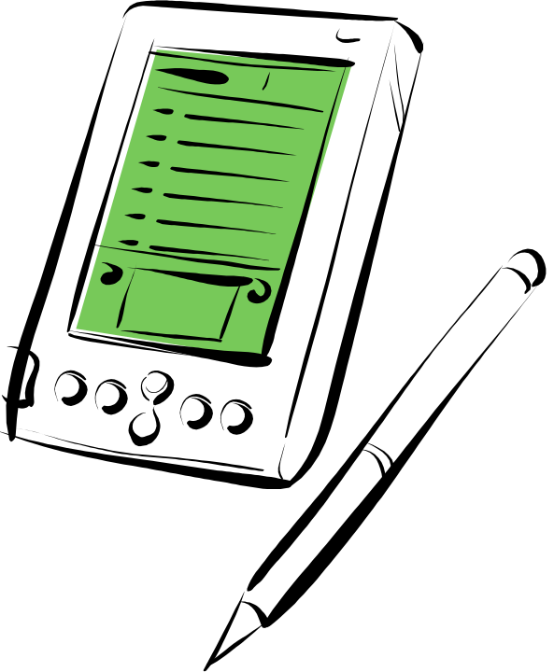
Handheld
Also called a PDA (Personal Digital Assistant).
A computer that fits into a pocket, runs on batteries, and is used while holding the unit in your hand.
Typically used as an appointment book, address book, calculator, and notepad.
Can be synchronized with a personal microcomputer as a backup.
Computer System

Slide 31
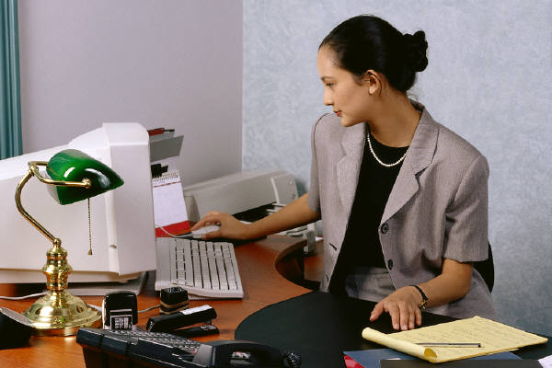
Types of Computers
Computer System

Slide 32


Types of computer
Type of computer
Digital computer
Analog computer
Hybrid Computer
Micro Computer
Main frame
Computer
Super Computer
Mini Computer
Home
PC

Slide 33
Analog computer
Analog computer measures and answer the questions by the method of “HOW MUCH”. The input data is not a number infect a physical quantity like tem, pressure, speed, velocity.
Accuracy 1% Approximately
Output is continuous
Time is wasted in transmission time

Slide 34
Packaging the Computer
Fast Expensive Complex Large
The many physical forms of the general purpose computer:
  All follow general organization:
    Primary memory
    Input units
    Output units
    Central Processing Unit
  Grouped according to speed, cost, size, and complexity.
Super Computers
Mainframe Computers
Minicomputers
Microcomputer
Palmtop Computer
Calculator
Slow Cheap Simple Small
The Computer Continuum
3-<number>
Notes:
Chapter 3
The Computer Continuum

Slide 35
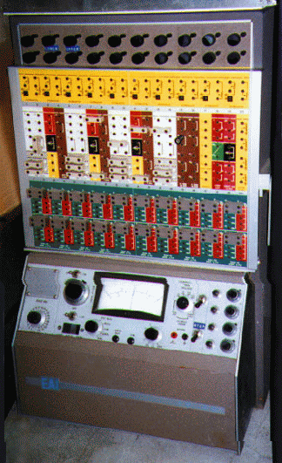
Analog computer

Slide 36
Digital Computers
Digital computer counts and answer the questions by the method of “HOW Many”. The input data is represented by a number. These are used for the logical and arithmetic operations.
Accuracy unlimited

Slide 37
Micro Computer
Micro computer are the smallest computer system. There size range from calculator to desktop size. Its CPU is microprocessor. It also known as Grand child Computer.
Application : - personal computer, Multi user system, offices.

Slide 38
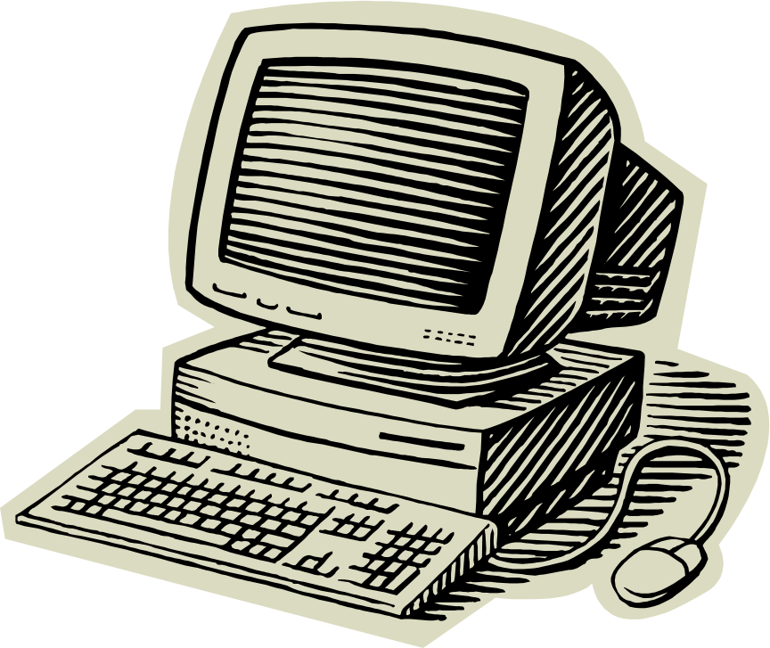
Microcomputer
A personal computer; designed to meet the computer needs of an individual.
Provides access to a wide variety of computing applications, such as word processing, photo editing, e-mail, and internet.
Computer System

Slide 39
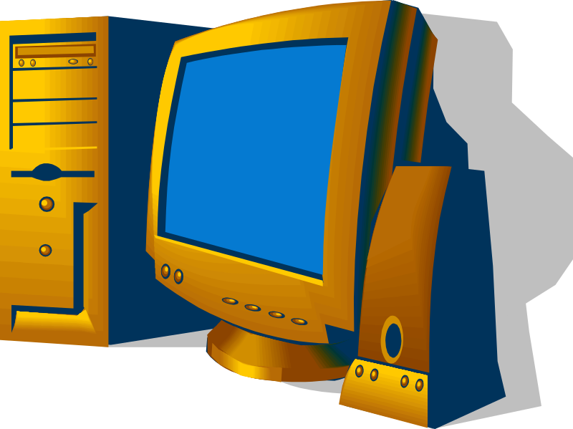
Desktop Microcomputer
A microcomputer that fits on a desk and runs on power from an electrical wall outlet.
The CPU can be housed in either a vertical or a horizontal case.
Has separate components (keyboard, mouse, etc.) that are each plugged into the computer.
Computer System

Slide 40
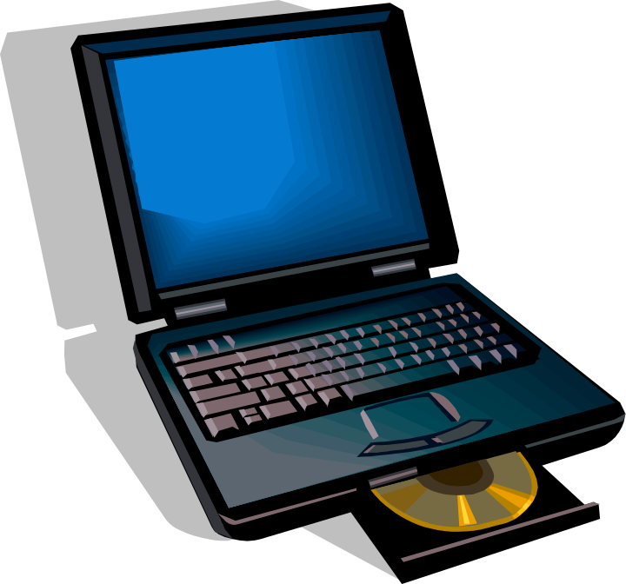
Laptop Computer
A portable, compact computer that can run on an electrical wall outlet or a battery unit.
All components (keyboard, mouse, etc.) are in one compact unit.
Usually more expensive than a comparable desktop.
Sometimes called a Notebook.
Computer System

Slide 41
Handheld
Also called a PDA (Personal Digital Assistant).
A computer that fits into a pocket, runs on batteries, and is used while holding the unit in your hand.
Typically used as an appointment book, address book, calculator, and notepad.
Can be synchronized with a personal microcomputer as a backup.
Computer System

Slide 42
Workstation
Powerful desktop computer designed for specialized tasks.
Can tackle tasks that require a lot of processing speed.
Can also be an ordinary personal computer attached to a LAN (local area network).
Computer System

Slide 43
Mini Computer
These are also small general purpose system. They are generally more powerful and most useful as compared to micro computer. Mini computer are also known as mid range computer or Child computer.
Application :- Departmental systems, Network Servers, work group system.

Slide 44
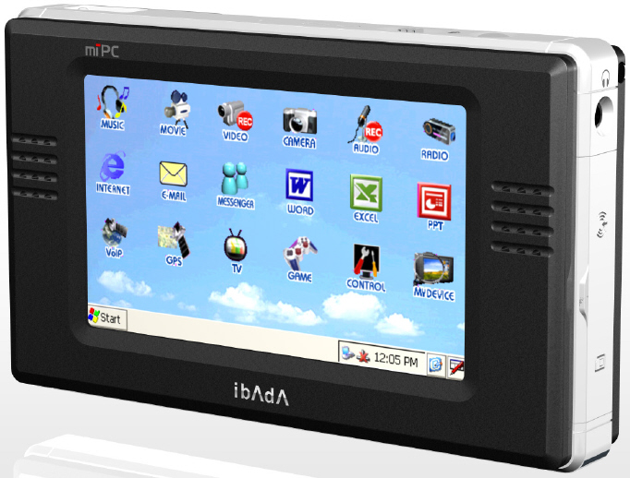
Mini computer

Slide 45
Main Frame Computer
Mainframe computers are those computers that offer faster processing and grater storage area. The word “main frame” comes from the metal frames. It is also known as Father computer.
Application – Host computer, Central data base server.

Slide 46
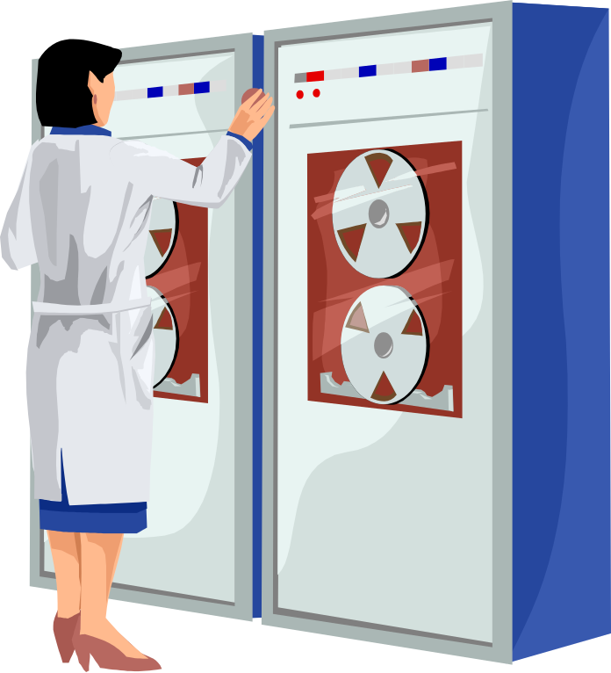
Mainframe
Large expensive computer capable of simultaneously processing data for hundreds or thousands of users.
Used to store, manage, and process large amounts of data that need to be reliable, secure, and centralized.
Usually housed in a closet sized cabinet.
Computer System

Slide 47

Super Computer
Super computer are those computer which are designed for scientific job like whether forecasting and artificial intelligence etc. They are fastest and expensive. A super computer contains a number of CPU which operate in parallel to make it faster. It also known as grand father computer.
Application – whether forecasting, weapons research and development.

Slide 48
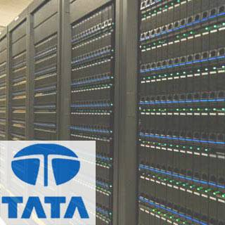
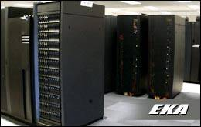
Super computer

Slide 49
Classification of Digital computer
Desktop
Workstation
Notebook
Tablet PC
Handheld computer
Smart Phone

Slide 50
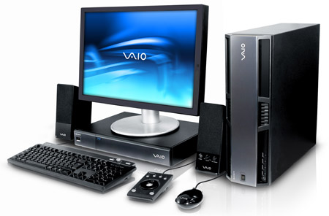
workstation

Slide 51
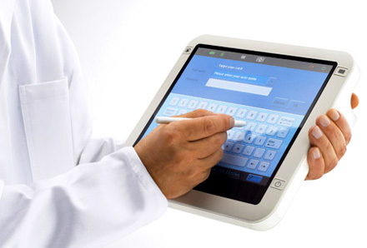
Tablet PC

Slide 52
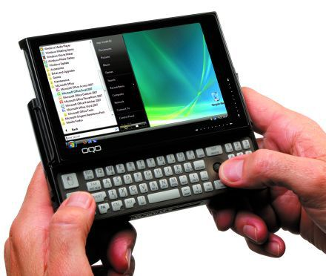
Handheld PC(PDA)

Slide 53
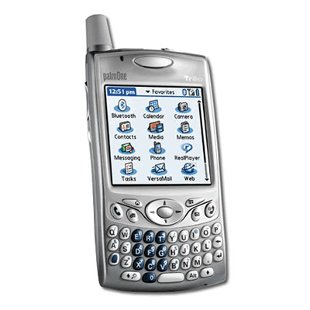
Smart phone

Slide 54
History of Computers
First(1945-1955): Used vacuum tubes. Were very large. Generated immense heat. Very expensive.
Second(1955-1965): Used transistors. Continued to be large and expensive.
Third(1965-1975): Used integrated circuits. Significant reduction in size and cost
Fourth(1975-1995): Uses Very Large Scale Integration. Desktop computers would not have been possible without VLSI. It used Microprocessor minimizing the size of P.C.
Fifth (in progress): Will provide us with Artificial intelligence. Also called knowledge information processing system

